Slide 1
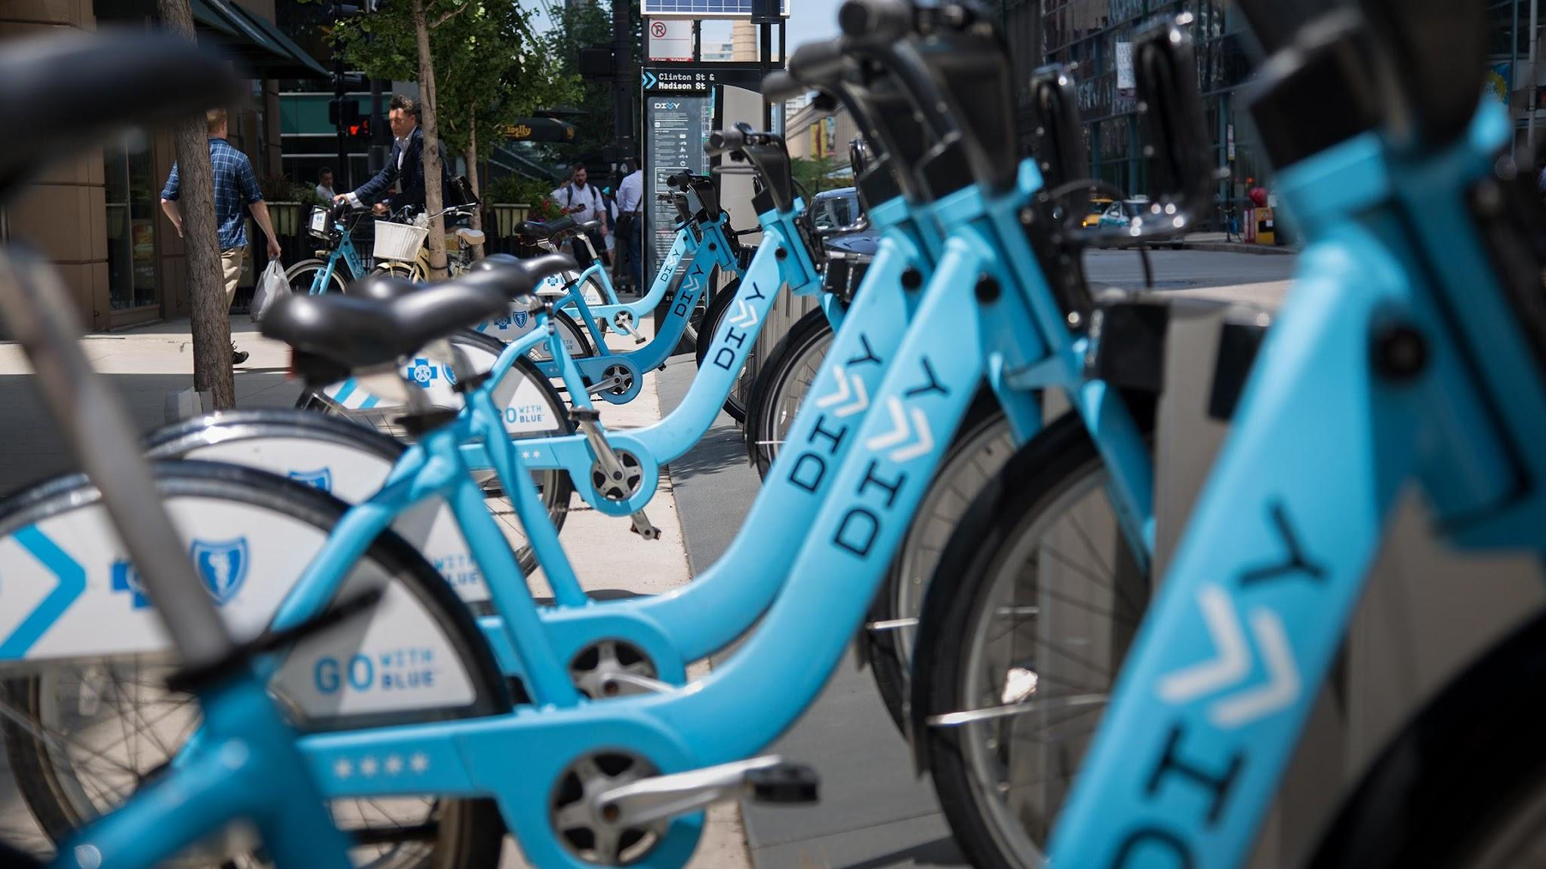

Case study: How to retain casual riders?
Pablo Serrano Medina
07 March 2024
Dates of analysis: from March 2023 to Feb 2024

Slide 2
Case study: How to retain casual riders?
Pablo Serrano Medina
07 March 2024
Dates of analysis: from March 2023 to Feb 2024

Slide 3
Content
Problem to solve
Data Sources
Summary of Analysis
Recommendations

Slide 4
Design marketing strategies aimed at convert Cyclistic’s casual riders into annual members
Problem

Slide 5
How do annual members and casual riders use Cyclistic bikes differently?
Guiding Question

Slide 6
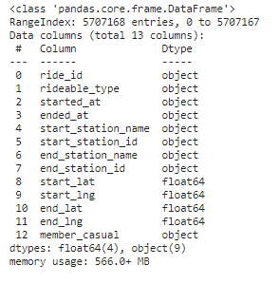
Data Sources
Cyclistic Bike Trip Data
Latest 12 months of historial bike trip data. From March 2023 to Feb 2024.
More than 5.000.000 entries
Note: Visit this Kaggle notebook for full data cleaning, transformation, and analysis.

Slide 7
Analysis

Slide 8
# 1 Casual’ rides are longer
(minutes) | Member | Casual
Mean | 12.73 | 28.28
Median | 8.5 | 11.9
Mode | 4.8 | 6.13

Slide 9
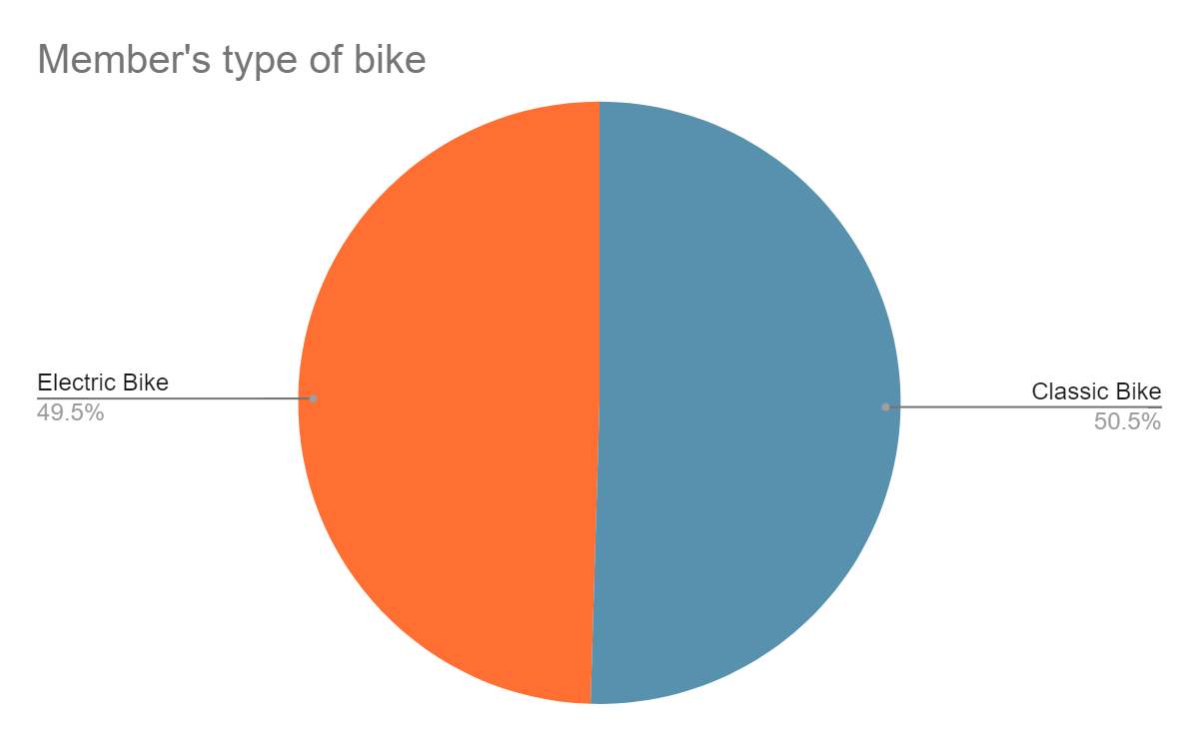
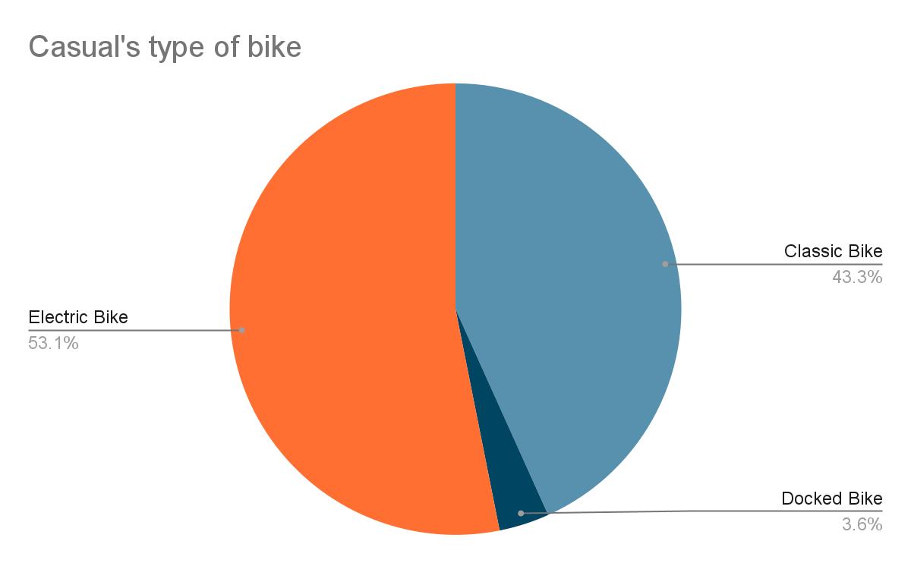
# 2 Casuals ride electric bikes more often
(minutes) | Member | % of total | Casual | % of total
Classic Bike | 12.73 |  | 28.28
Docked Bike | 8.5 |  | 11.9
Electric Bike | 53% |  | 6.13

Slide 10
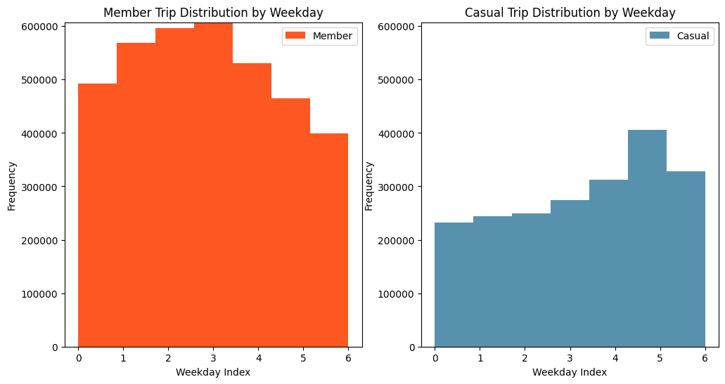
# 3 Casuals ride more in the weekends
Note: 0 is Monday, 1 is Tuesday,..., 7 is Sunday.

Slide 11
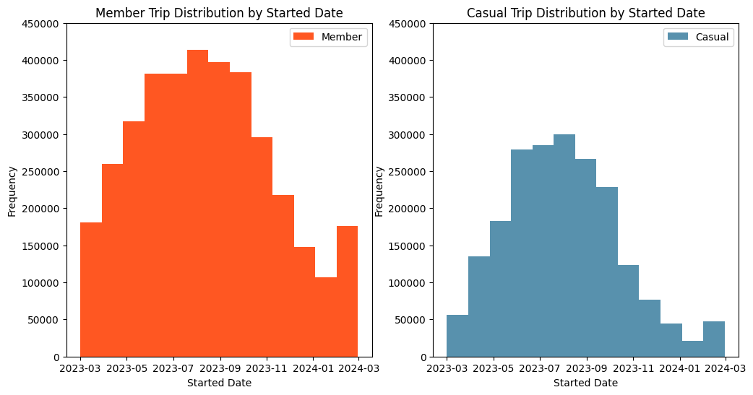
# 4 All users ride more in Summer/Spring

Slide 12
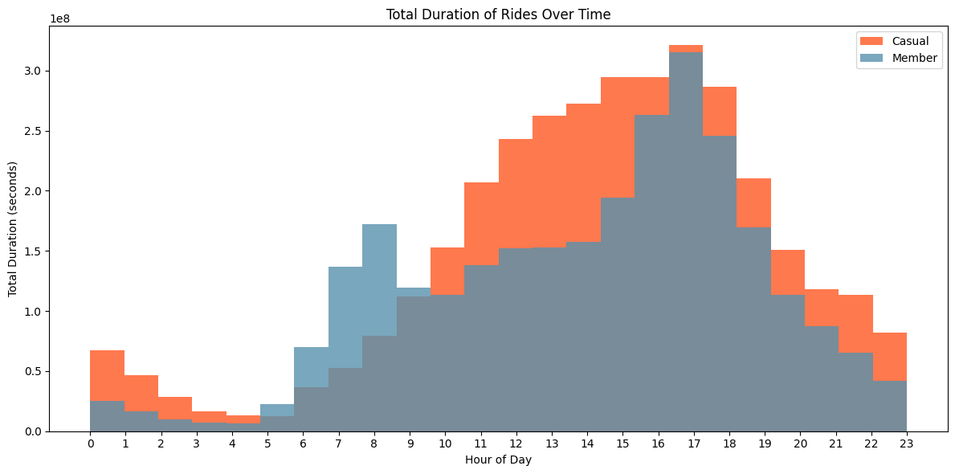
# 5 Members for commuting, Casuals for leisure.
Commuting hours

Slide 13
Summing up
# 1 Casual’ rides are longer.
# 2 Casuals ride electric bikes more often.
# 3 Casuals ride more often during the weekends.
# 4 All users ride more often in Summer/Spring.
# 5 Members for commuting, Casuals for leisure.

Slide 14
How can these conclusiones help us to convert casual riders into annual members?

Slide 15
Recommendations
# Ads campaigns of commuters in cloudy, busy days.
People associate these bike-sharing services with free time and sunny days thanks, partially, to their campaigns. We suggest a campaign focusing on how Cyclistic saves you time from traffic jams and waiting for the bus. Changing the narrative.
# Offers in Autumn
After the Summer peak of casual users, launching a 3-month or 6-month promotion to retain those riders throughout autumn or even winter.

Slide 16
Full analysis walkthrough
pavloatlas.com

